Slide 1
Music, Language, and Computational
Modeling: Lessons from the Key-Finding Problem
David Temperley
Eastman School of Music
University of Rochester

Slide 2
1. Music, Language, and
Computational Modeling:
The Big Picture

Slide 3
Theoretical linguistics
L A N G U A G E
Psycholinguistics (neurolinguistics, etc...)
C O G N I T I O N
Computational
psycholinguistics
Natural language
processing

Slide 4
Theoretical linguistics
L A N G U A G E
Psycholinguistics (neurolinguistics, etc...)
C O G N I T I O N
Computational
psycholinguistics
YOU
Natural language
processing

Slide 5
Theoretical linguistics
L A N G U A G E
Psycholinguistics (neurolinguistics, etc...)
C O G N I T I O N
Computational
psycholinguistics
YOU
Natural language
processing

Slide 6
Theoretical linguistics
L A N G U A G E
Psycholinguistics (neurolinguistics, etc...)
C O G N I T I O N
Computational
psycholinguistics
Music theory
M U S I C
Music psychology
C O G N I T I O N
Computational
music cognition
YOU
Natural language
processing
Music information
retrieval

Slide 7
Theoretical linguistics
L A N G U A G E
Psycholinguistics (neurolinguistics, etc...)
C O G N I T I O N
Computational
psycholinguistics
Music theory
M U S I C
Music psychology
C O G N I T I O N
Computational
music cognition
YOU
Natural language
processing
Music information
retrieval
ME

Slide 8
The topic of today’s talk: The Key-Finding Problem
(how key is identified, other implications of key for
music cognition)
Work in computational music cognition has been greatly
influenced by NLP / computational linguistics (as you’ll see)
BUT the influence could also go the other way—my
work on key raises some fundamental issues about cognition
that have implications for language as well.

Slide 9
2. KEY – A Brief Introduction
A key is a framework in which the pitches of a piece are
understood.
Pitch-
classes
C C# D Eb E F F# G Ab A Bb B (C...)
Notes:
There are really just 12 pitch categories, which we call pitch-classes, and as you go up the piano keyboard you just cycle through these 12 categories.

Slide 10
C MAJOR
Tonic triad
Scale
Pitch-
classes
C C# D Eb E F F# G Ab A Bb B (C...)
Notes:
There are 12 pitch-classes. Each key is named after a pitch-class. So this is the key of C major. Each key is associated with a scale, or a set of pitch-classes. So the key of C major has this scale. And each key is also associated with a chord, or triad, three notes that are especially stable or central within the key. So there are also major keys and minor keys. The C minor scale has a different pattern. To generate other keys, you just shift these patterns up or down. Importance of key: function of notes depends on position within key.

Slide 11
C MINOR
Tonic triad
Scale
Pitch-
classes
C C# D Eb E F F# G Ab A Bb B (C...)

Slide 12
C# MAJOR
Tonic triad
Scale
Pitch-
classes
C C# D Eb E F F# G Ab A Bb B (C...)

Slide 13
Key is a central concept in music—operative in some form in nearly all styles of Western music (classical, jazz, folk, rock...)
A key provides the framework in which the pitches of a piece are understood. For example, the tonic pitch—the pitch after which the key is named—is especially stable and usually appears at the end of a melody. But to know which pitch is the tonic, you first have to identify the key.
Notes:
The function of a pitch depends on its position in relation to the key.

Slide 14
Are listeners sensitive to key?
Yes: Given a context that establishes a key, followed by a single pitch or “probe-tone,” listeners (even without musical training) can detect whether the probe-tone is
in the scale of the key (Krumhansl 1990).

Slide 15
3. The Key-Finding Problem
A big question: How do listeners identify the key of a piece as they hear it?
This is the key-finding problem—a major problem in music cognition. (Also an important problem in music
information retrieval.)

Slide 16
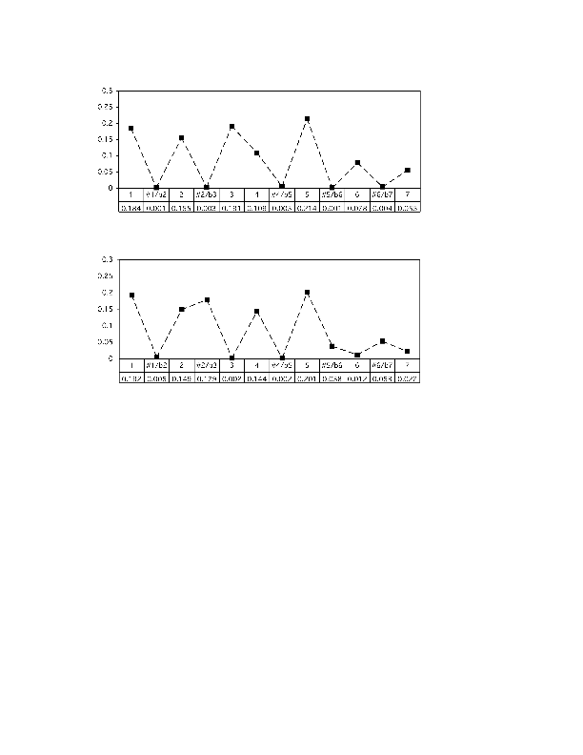
A Generative Probabilistic Approach (This is the monophonic key-finding model in Temperley, Music and
Probability [2007])
For each key, look at the probability (frequency of occurrence) of each pitch-class given that key. We call
this distribution a key-profile. For C major:
C C# D Eb E F F# G Ab A Bb B (C...)

Slide 17
Then for a given piece, calculate the probability of generating the notes of that piece, given each key.
P(notes | key) = Π K_{n}
where K_{n} are the key-profile values for all the notes in the piece.
By Bayesian logic:
P(key | notes) ∝ P(notes | key) × P(key)
We assume that all keys are equal in prior probability, P(key) = 1/24. Thus the key that generates the notes with highest probability is the most probable key given the notes.
n

Slide 18
Testing the monophonic key-finding model (and two other models) on European folk melodies (E) and Bach fugue melodies (B)
E B
Temperley monophonic model 87.7% 89.6%
Krumhansl (1990) 75.4% 66.7%
Longuet-Higgins & Steedman (1971) 70.8% 100.0%

Slide 19
4. The probabilities of note patterns
The monophonic key-finding model can also be used to estimate the probability of a pitch sequence:
P(notes) = ∑P(notes, key) = ∑P(notes | key)P(key)
= ∑ Π K_{n} (1/24)
Intuitively, some pitch patterns are likely within the
style of tonal music; some are not. (Roughly speaking,
those that stay within a single scale are more likely.)
key
key
key
n

Slide 20
We can also use this approach to model melodic expectation: Given a melodic context, what note will be expected next?
Expectation—the way expectations are created, fulfilled,
and denied—is thought to be an important part of musical
experience. (Think of the beginning of Beethoven’s “Eroica” symphony... )
In M&P, I modeled this using the monophonic key-finding
model. I also included two other factors—pitch proximity
(the tendency for note-to-note intervals to be small) and
range (the tendency for a melody to stay within a fairly narrow range of pitch).

Slide 21
Given a context of notes p₀...p_{n-1} and a continuation p_{n}, the expectedness of p_{n} given the context can be defined as its probability:
P(p_{n} | p₀...p_{n-1}) =
This term is constant for a given context. This term can be calculated using the formula stated above for the probability of a pitch sequence:
P(notes) = ∑ Π K_{n} (1/24)
Roughly speaking: A probable note is one that is within the key of the context.
Notice that this sums over all possible keys. That is: we consider all possible keys in judging what note will come next. (The marginal model)
P(p₀...p_{n})
P(p₀...p_{n-1})
(We factor in pitch proximity and
range as well – not explained here)
n
key

Slide 22
A connection with language (finally!)...
Levy (2008) proposes that the processing difficulty of
a word in context is related to its probability or
surprisal given the context: low probability (high surprisal) means greater processing difficulty.
Levy calculates P(w_{i}) by summing over the joint
probability of all possible syntactic structures T (compatible with w₀...w_{i}):
P(w_{i} | w₀...w_{i-1}) ∝ P(w₀...w_{i}) = ∑P(T )
In short: In predicting the next word, you consider all
possible syntactic structures given the prior context.
T

Slide 23
But...do people really calculate marginal probabilities?
In language, the ultimate aim is surely to identify the best (most probable) syntactic structure, not to predict the most probable next word. Summing over all syntactic structures is also very computationally expensive; is it even plausible that we do so?
Another possibility: We find the best (most probable) syntactic structure given the context (which we have to do anyway for parsing!) and use that to form expectations for the next word.
Similarly in melodic expectation: perhaps we calculate the most probable key given the context, then use that to predict the next note. (The maximal model)

Slide 24
In very general terms: We’re given a context of surface
events (words or notes) and want to calculate the probability of the next event. There’s some kind of underlying structure (a syntactic structure or key).
marginal model:
P(event | context) = ∑P(event, structure | context)
∝ ∑P(event, context, structure)
maximal model:
P(event | context) = P(event | context, structure*)
∝ P(event, context, structure*)
where structure* = argmax_{structure} P(structure | context)
structure
structure
(?)

Slide 25
Comparing the maximal and marginal models on
melodic expectation data
Experimental data from Cuddy & Lunney (1995): Subjects heard two-note contexts (N1 N2), followed by a one-note continuation (N3), and had to rate the expectedness of the continuation given the context (on a scale of 1 to 7). (200 3-note patterns altogether)
The maximal and marginal models were used to judge
P(N3 | N1 N2) for each pattern. Correlations were calculated between log probabilities and the subject
ratings.

Slide 26
Results
r
Marginal model .883
Maximal model .851
The marginal model does a bit better. So, there is some
evidence that people DO consider multiple keys in forming expectations for the next note of a melody...
...And more generally, that they have the ability to
calculate marginal probabilities.

Slide 27
5. Modulation and tension
The monophonic key-finding model yields a single key judgment for any piece. But many pieces change key or
modulate. How could a probabilistic key-finding model capture this?

Slide 28
One solution: Divide the piece into small segments
(corresponding to measures). The generative model chooses a key for each segment. The pitches for each segment are generated given the key of the segment, as described earlier.
The probability of a key in a segment depends on the key of the previous segment. (There is a high probability of staying in the same key from segment to segment; if we do change keys, some key changes are more likely than others, e.g. moves to “closely related” keys.)

Slide 29
So the structure of the model is like this:
Sets of
notes
Keys
Notes are observed; keys are hidden. So...a Hidden Markov Model! This is the polyphonic key-finding model in M&P.
A key structure is a series of key choices, one for each segment. The highest-probability key structure can be calculated using the Viterbi algorithm.

Slide 30
Note: The generation of notes is actually rather different
in the polyphonic model than in the monophonic model:
In the polyphonic model, rather than generating a set of notes (a multiset of pitch-classes), each segment simply generates an ordinary set of pitch-classes. But the basic principles are the same: The most probable pitches given a key are those in the scale and tonic triad of the key. And in most cases, the results are similar as well. In what follows, we can assume the same note-generation process I described before.

Slide 31
As before, we can use this model to calculate the
probability of a note pattern.
Strictly speaking (KS = key structure):
P(notes) = ∑ P(KS, notes)
In this case it really seems implausible that listeners consider all possible key structures. So we assume a maximal model:
P(notes) = P(KS*, notes) = P(notes | KS*) P(KS*)
where KS* = argmax_{KS} P(KS | notes)
KS
(?)

Slide 32
Once again:
P(notes) = P(KS*, notes) = P(notes | KS*) P(KS*)
Given a piece and a preferred key analysis KS*, we can estimate P(notes) for each segment of the piece.
If a section of the piece has few or no modulations, P(KS*) will be high. If the notes generally “fit” well with the preferred key in each segment, P(notes | KS*) will be high. If both of these conditions hold, P(notes) will be high.
If there are frequent modulations or if many notes are low in probability given the key (e.g. “chromatic” notes), P(notes) may be lower.
Perhaps this corresponds to musical tension?
(?)

Slide 33
Schumann, Papillons, first movement. What section of the piece seems highest in tension?
1 2 3 4 5 6
7 8 9 10 11
12 13 14 15 16

Slide 34
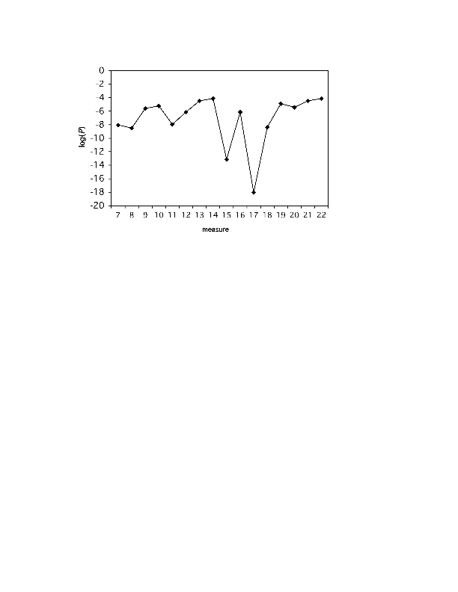
The model’s estimates of log (P(notes)) for each measure of the Schumann piece.
measure 1 2 3 4 5 6 7 8 9 10 11 12 13 14 15 16

Slide 35
Define tension as negative log P; so we just flip the graph upside down.
The section that seems highest in tension, measures 9-12, is also judged to be high in tension by the model.
measure 1 2 3 4 5 6 7 8 9 10 11 12 13 14 15 16

Slide 36
Negative log P can also be construed as information.
Listen to Sviatoslav Richter’s performance, especially the expressive timing (“rubato”). Where does he slow down the most?
measure 1 2 3 4 5 6 7 8 9 10 11 12 13 14 15 16

Slide 37
Negative log P can also be construed as information.
Listen to Sviatoslav Richter’s performance, especially the expressive timing (“rubato”). Where does he slow down the most? On mm. 11 and 12—the part of the piece that is lowest in probability, thus highest in information.
measure 1 2 3 4 5 6 7 8 9 10 11 12 13 14 15 16

Slide 38
A connection with language...
Levy & Jaeger’s Uniform Information Density Hypothesis (2007) asserts that a certain rate of information flow is optimal for language comprehension, and that language production tends to be adjusted to maintain this rate: For example, low-probability words (in context) are spoken more slowly.
It appears that the same is true in music: Low-probability events are performed more slowly (Bartlette, 2007).

Slide 39
6. More about maximal models
We have a surface S, and underlying structures T. The goal is to find a model that estimates P(S): we call that a surface model.
A maximal model takes P(T*, S) as an
estimate of P(S), where T* = argmax_{T} P(T | S).
This is an appealing idea, because its computational cost is zero: calculating P(T*, S) is (presumably) something we have to do anyway.

Slide 40
Think of the total probability mass as a region on a plane (area = 1).
A particular surface S is a sub-region of this region, whose area equals P(S). The joint probability of a surface and a structure, P(T, S), is a sub-region of P(S). The largest sub-region of P(S) is P(T*, S).
P(T*, S)
P(S)

Slide 41
A marginal model computes P(S) by adding all its sub-regions. A maximal model takes P(T*, S) to represent P(S).
An example of a maximal model in music would be a surface model that considers only the best key structure in calculating the P of a note pattern. An example in language would be a model that considers only the best syntactic analysis in calculating the P of a word sequence (Chelba & Jelinek 1998).
P(T*, S)
P(S)

Slide 42
Let’s call P(T*, S) the maximal joint probability. I mentioned earlier that a low value of this can give rise to tension (=uncertainty, anxiety). Why would this be?
Three possible reasons...
1. Low-probability surfaces are high in information, and thus more difficult to process (discussed earlier).

Slide 43
2. Taken as an estimate of P(S), P(T*, S) provides a evaluation measure for our model of the language (or musical style).
Just like a language model in speech recognition (Jelinek 1997), the best model of a language or musical style is the one that assigns it highest probability. If our P(S) judgments are low, that tells us that perhaps our model needs to be refined. (Think of a child learning the language.)

Slide 44
3. Here’s where things get a bit flaky and half-baked...
Assume a maximal model. And assume that we’re not doing an exhaustive search. Rather, we do a beam search (beam width = 1): we’re only maintaining one analysis at a time. In that case, we know P(T_{c}, S), where T_{c} is the currently-preferred structure (not necessarily T*). We do not know
P(T, S) for other structures.

Slide 45
3. Here’s where things get a bit flaky and half-baked...
Assume a maximal model. And assume that we’re not doing an exhaustive search. Rather, we do a beam search (beam width = 1): we’re only maintaining one analysis at a time. In that case, we know P(T_{c}, S), where T_{c} is the currently-preferred structure (not necessarily T*). We do not know
P(T, S) for other structures.
P(T_{c}, S)

Slide 46
In that case, P(T_{c}, S) might also be taken as a measure of how good T_{c} is. That is, if P(T_{c}, S) is low, we might take that as an indication that we haven’t found the best structure (some other sub-region of P(S) is larger)—we need to reanalyze.
P(T_{c}, S)
Now P(T_{c}, S)
is relatively high...

Slide 47
In that case, P(T_{c}, S) might also be taken as a measure of how good T_{c} is. That is, if P(T_{c}, S) is low, we might take that as an indication that we haven’t found the best structure (some other sub-region of P(S) is larger)—we need to reanalyze.
P(T_{c}, S)
Now P(T_{c}, S) is low—so
probably T_{c} is not T*!
Note: Now we’re not using P(T_{c}, S) as an estimate of P(S)!

Slide 48
This might account in part, for the tension of listening to music. By this view, tension arises because P(T_{c}, S) is low, calling into question whether the structure we have chosen is really the right one.
If P(T_{c}, S) then rises, we are reassured that our choice was correct, creating a feeling of relief. (Or perhaps we switch to a different structure, whose probability is higher.)
Think of the “Eroica” again. First Eb major seems like a good key; then it seems doubtful; then it seems good again.

Slide 49
Connections with language?
What about humor? Some jokes involve playing with our syntactic/semantic probabilities. Our initial interpretation of the sentence makes little sense (causing anxiety); then we find another interpretation, not previously considered, which is higher in probability (causing relief).

Slide 50
Q: What has four wheels and flies?
“Flies” is understood as a verb; P(T_{c}, S) is low—when semantics is considered!—because nothing fits this description.

Slide 51
Q: What has four wheels and flies?
“Flies” is understood as a verb; P(T_{c}, S) is low—when semantics is considered!—because nothing fits this description.
A: A garbage truck.
Now “flies” is reinterpreted as a noun, and P(T_{c}, S) is
suddenly much higher; we can be confident that this is the correct interpretation.

Slide 52
Summary
1. A simple, generative probabilistic model performs well
at key-finding.
2. The model be used to estimate the probabilities of note patterns—a surface model. Two ways of doing this:
A. Marginal model (the “correct” way, strictly speaking)
B. Maximal model (appealing because it emerges from structure-finding process with no additional computation)
3. A surface model can be used to model melodic expectation (a marginal model does slightly better here).

Slide 53
Summary (2)
4. The key-finding model can also be applied on a measure-by-measure basis—as a Hidden Markov Model.
5. As such, the model can also be used to model musical tension (assuming a maximal surface model).
6. Tension can also be construed as information: Following the Uniform Information Density hypothesis, this leads to a prediction about expressive timing (more rubato when tension is higher).

Slide 54
Summary (3)
7. If a maximal model is assumed, and a non-exhaustive search process, then P(T_{c}, S) may be an indication of how good T_{c} is. This may account, in part, for musical tension: tension arises when the search is going badly. And it might have implications for language too—e.g., humor.

Slide 55
Thank you!

